Slide 1
IBM University Engagement Project Submission
“Exploring the Power of Agentic AI with IBM Granite and IBM Bob”

Slide 2

Project Tile – Research Agent – AI-Powered Academic & Scientific Research Assistant
Domain of Project – Education & Academic Research
Student Name | Recent Passport Photo | Email ID | Mobile number [WhatsApp]
Recommended font style and size: Font Style: Arial Font Size (Heading): 28
Font Size (Content): 20

Slide 3
Problem Statement -
Problem Statement : Research Agent
The Challenge
Researchers, students, and faculty often struggle with the overwhelming volume of academic literature, making manual literature search, summarization, and reference organization extremely time-consuming and error-prone. Relevant information is scattered across multiple databases, journals, and repositories, making it difficult to extract insights quickly or draft research content without significant manual effort.
The Objective
Build an AI-powered Research Agent that assists with academic and scientific research tasks for students, faculty, and R&D teams. The solution should:
Literature Search & Retrieval – Autonomously search for relevant papers and literature across trusted academic sources.
Summarization Engine – Summarize research papers and long documents into concise, digestible insights.
Reference & Citation Management – Organize references, generate citations, and maintain bibliography formats automatically.
Hypothesis & Draft Generation – Suggest research hypotheses and draft sections of research papers from retrieved literature.
Multi-Agent System –
Literature Search Agent (retrieves relevant papers and articles)
Summarization Agent (condenses papers into key insights)
Citation & Reference Agent (manages citations and bibliography)
Report & Draft Generation Agent (drafts report sections and suggests hypotheses)
Research Dashboard – Show search history, saved papers, citation graphs, and drafting progress in one place.

Slide 4
Proposed Solution -
Proposed Solution: AI-Powered Research Agent
The proposed solution is a multi-agent AI-powered Research Agent built using IBM Bob, IBM watsonx.ai, and Granite Models to automate literature search, summarization, and drafting for academic and scientific research. The system addresses challenges in information overload, citation management, and repetitive research tasks through an intelligent, modular architecture.
At its core, the solution uses a Retrieval-Augmented Generation (RAG) pipeline to fetch accurate literature from trusted academic sources such as arXiv, Google Scholar, and institutional repositories. This data is embedded and stored in a vector database, enabling the system to retrieve and summarize relevant papers using Granite models.
The system consists of four key agents:
Literature Search Agent retrieves relevant papers, articles, and literature from trusted academic databases using RAG.
Summarization Agent condenses lengthy papers into concise summaries and key takeaways.
Citation & Reference Agent organizes citations, manages bibliographies, and ensures correct referencing formats.
Report & Draft Generation Agent suggests hypotheses and drafts sections of research papers based on retrieved literature.
The solution includes a research dashboard (built with Streamlit or React) that visualizes saved papers, citation graphs, search history, and drafting progress.
IBM Bob is used to orchestrate agent workflows, while watsonx.ai ensures scalable model deployment, embeddings, and AI governance. Granite models power reasoning, summarization, and text generation.
Overall, this solution delivers an end-to-end intelligent research assistant that saves researchers time by automating literature review, citation management, and draft generation.

Slide 5
Technology Used
IBM Bob platform -For designing and orchestrating multi-agent workflows visually
IBM Grainte model - for eg – ibm-granite-3-2-8b – For natural language understanding, reasoning, and personalization
IBM Cloud – It provides the infrastructure to build, deploy, and scale the Research Agent efficiently. IBM Cloud enables a reliable, secure, and scalable environment for deploying the Research Agent.
RAG– RAG to fetch real data first, then generate intelligent answers, making the Research Agent more trustworthy and effective.
IBM Watsonx.ai - For model deployment, embeddings, and AI governance
Vector Database (FAISS/Chroma) – For RAG-based literature and reference retrieval

Slide 6
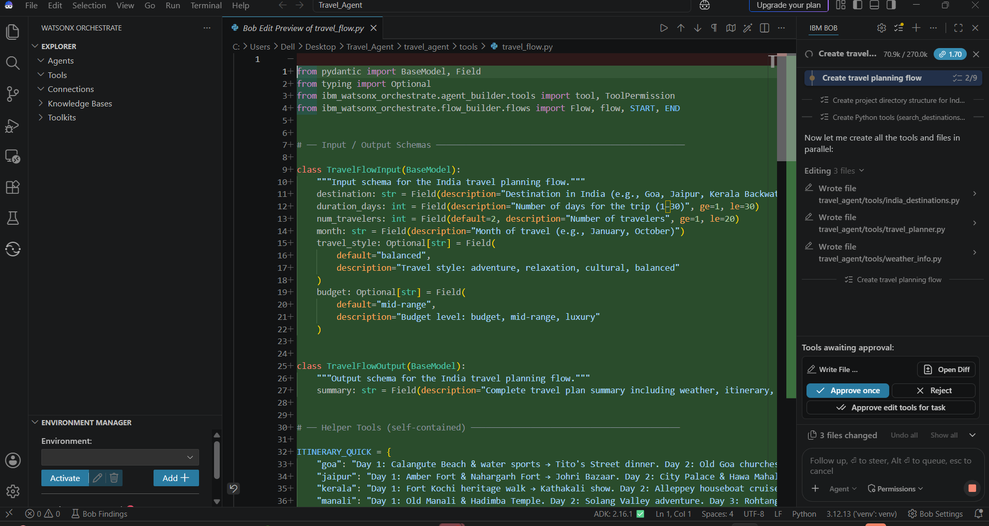
Required Files created using IBM bob -

Slide 7
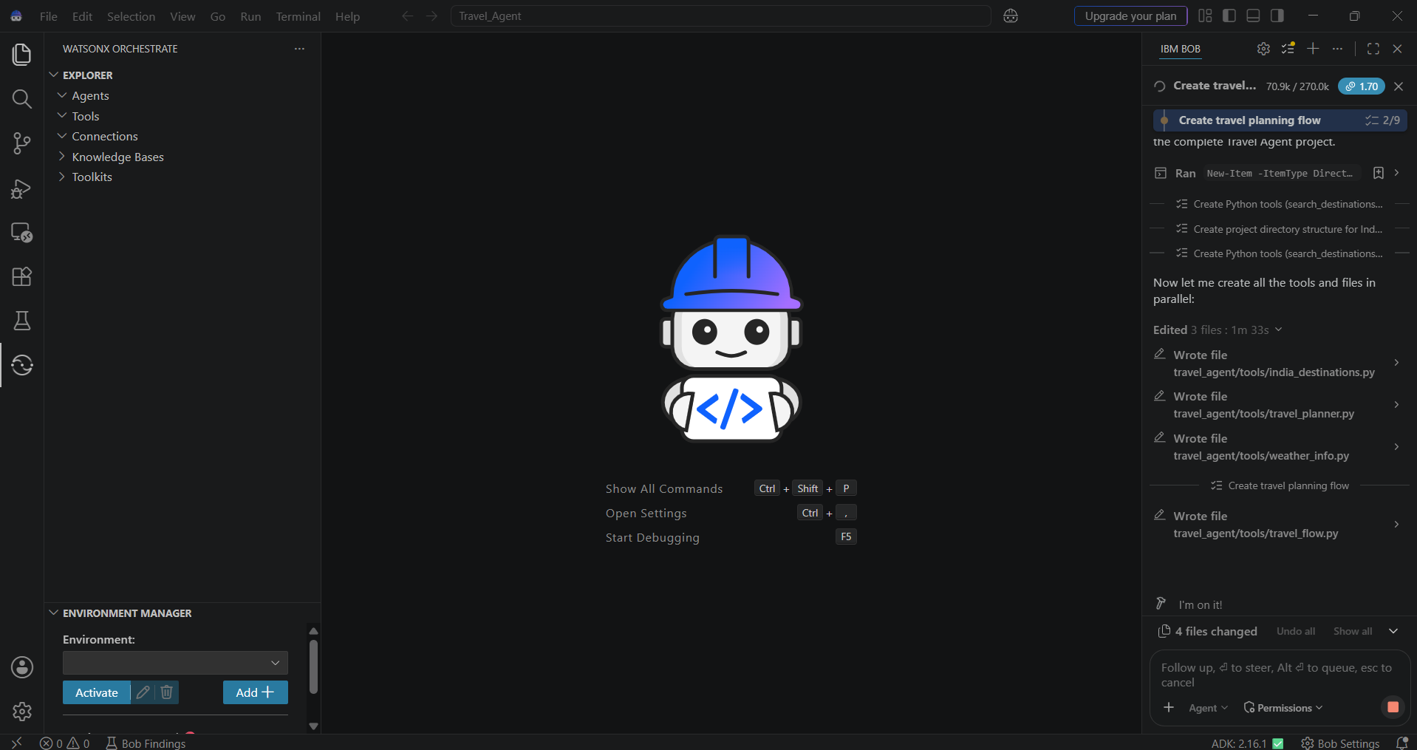
IBM Bob Screenshots:

Slide 8
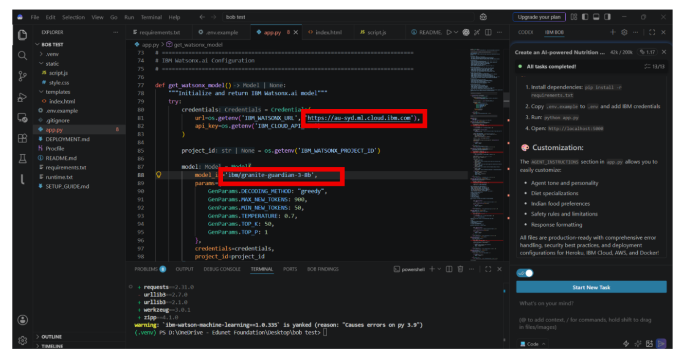

Slide 9
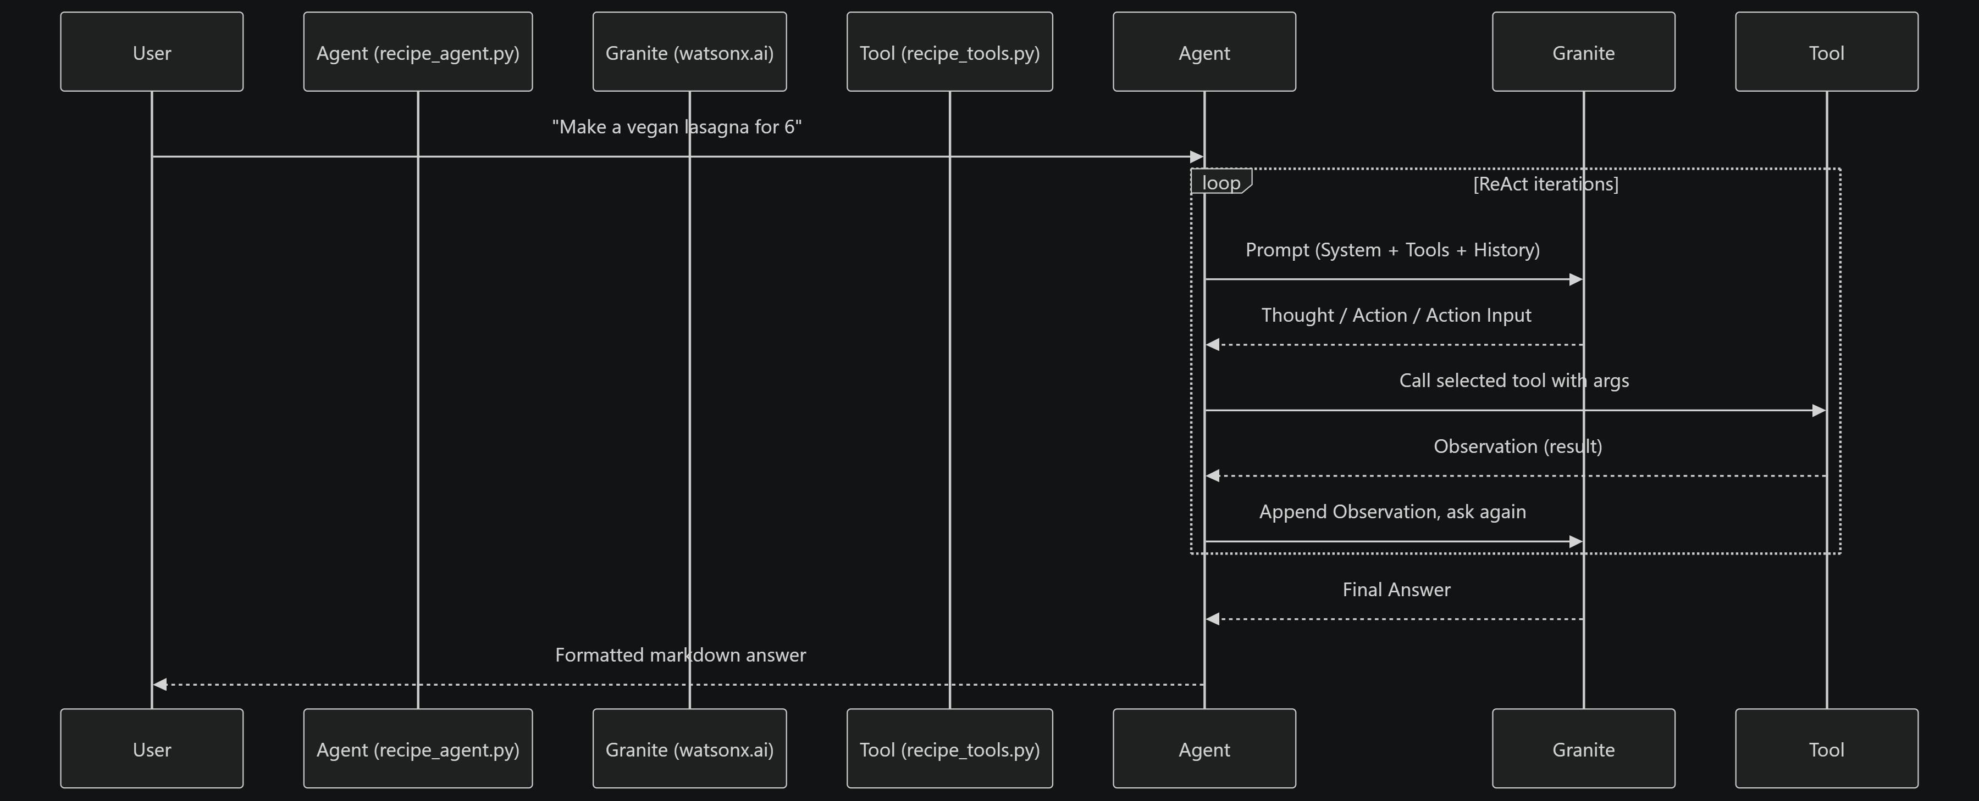
Architecture blueprint for IBM bob:

Slide 10

Role of Agentic AI in the solution
Role of Agentic AI in Research Agent
Agentic AI enables the Research Agent to function as an intelligent, autonomous system rather than a simple search tool. Using IBM watsonx.ai and IBM Granite models, it coordinates multiple specialized agents to deliver personalized research assistance.
Each agent performs a specific role—such as searching literature, summarizing papers, managing citations, and drafting report sections—while working collaboratively. This multi-agent approach ensures efficient task execution and accurate results.
Agentic AI also brings context awareness, understanding user details like research domain, topic scope, and citation style to generate tailored outputs. It supports real-time adaptation, continuously refining searches and drafts based on researcher feedback.
Additionally, agents communicate with each other, enabling better decision-making and improved outcomes.
Overall, Agentic AI makes the system proactive, personalized, and goal-driven, acting like a smart digital research assistant that helps researchers accelerate literature review, writing, and discovery.

Slide 11


Token Usage
11,761 token are used
Before Prompt
After the Prompt
·
·
·

Slide 12
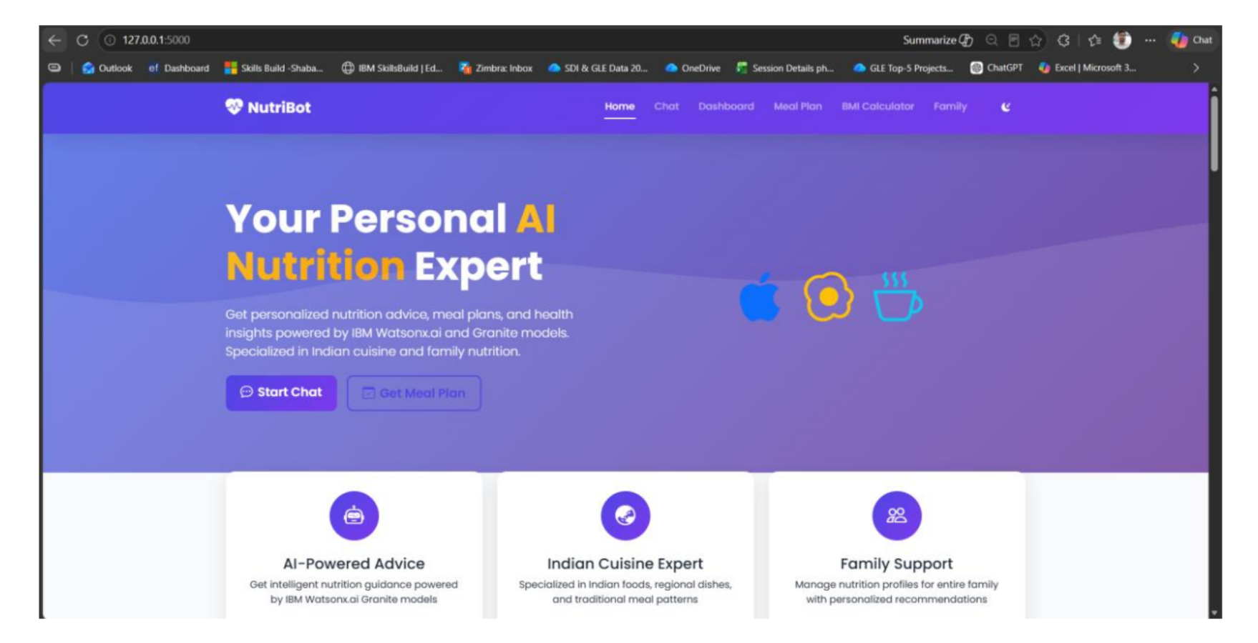
Project Output Screenshot
Please put IBM Bob output screenshots with 2-3 prompts.
You can take 2-3 more slides for each screenshot
·
·
·

Slide 13
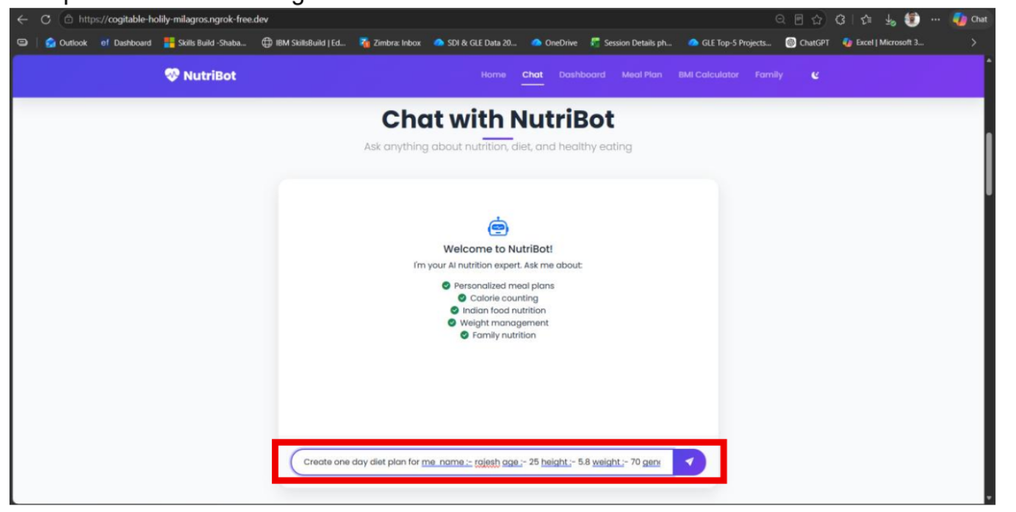
Project Output Screenshot
Please put IBM Bob output screenshots with 2-3 prompts.
You can take 2-3 more slides for each screenshot
·
·
·

Slide 14
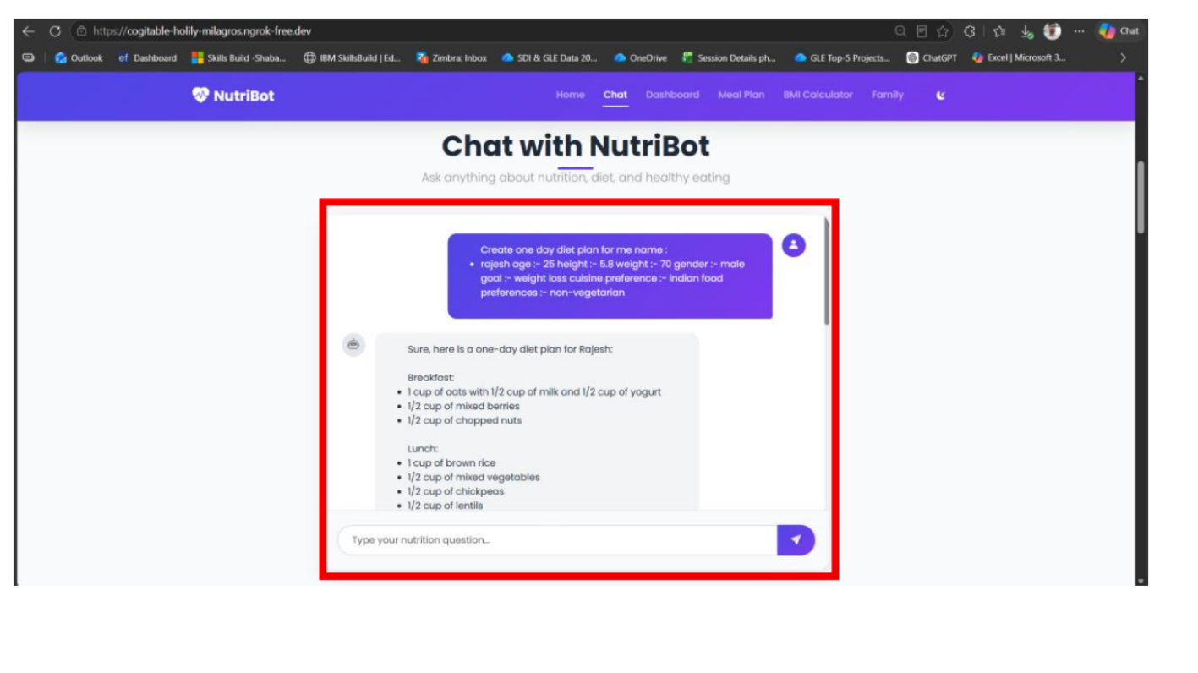
Project Output Screenshot
Please put IBM Bob output screenshots with 2-3 prompts.
You can take 2-3 more slides for each screenshot
·
·
·

Slide 15
Novelty and Uniqueness
The proposed Research Agent stands out by combining Agentic AI, RAG, and automation into a single intelligent system.
Multi-Agent Intelligence – Instead of a single search tool, multiple specialized agents collaborate to deliver accurate literature search, summarization, and drafting.
RAG-Based Accuracy – Integrates real-time literature retrieval with AI generation, reducing hallucination and ensuring trustworthy citations.
Faster Literature Review – Cuts down hours of manual paper reading into minutes of AI-assisted summarization.
Real-Time Feedback Loop – Continuously adapts drafts and searches based on researcher feedback.
Automated Citation Management – Organizes references and generates properly formatted bibliographies automatically.
Draft Generation Support – Goes beyond search to help draft hypotheses and paper sections.
Scalable & Enterprise-Ready – Built on IBM watsonx.ai with IBM Granite models, ensuring reliability and governance.
This makes the solution a smart, adaptive, and proactive digital research assistant, not just a static search engine.

Slide 16
Git Hub Link
· Please create public github repository (Enable Add README button while creating repository) with format –
Please test and Paste the working Github URL –
Make sure you have Uploaded following three files into your github repository 1) All Agent relevant files of IBM Cloud , 2) yourproblemstatement.pdf file 3) your projectpresntation.pptx file 4)any other files
·
·
·

Slide 17
Future Scope
1. Integration with Live Academic Databases & APIs –
The system can be integrated with live APIs from IEEE, Springer, PubMed, and Scopus to fetch the latest publications in real time. This will enable the Research Agent to provide more current and comprehensive literature coverage beyond static datasets.
2.AI-Powered Voice Assistant & Multilingual Support –
Enhancing the system with a voice-enabled assistant and support for multiple regional languages will improve accessibility for researchers. Users can interact naturally in their preferred language and dictate queries, making the solution more inclusive for diverse academic communities.
·
·
·

Slide 18
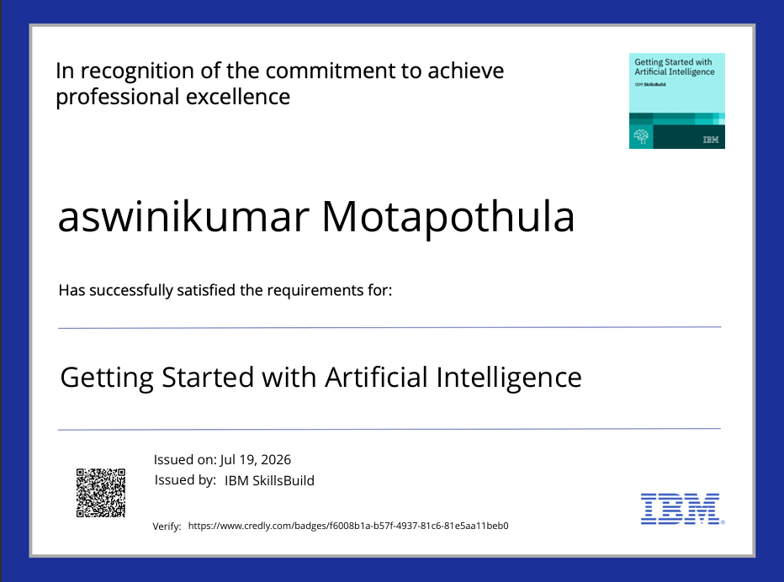
Certificates Earned:
Please add your credly certificate(Getting Started with Artificial Intelligence)

Slide 19
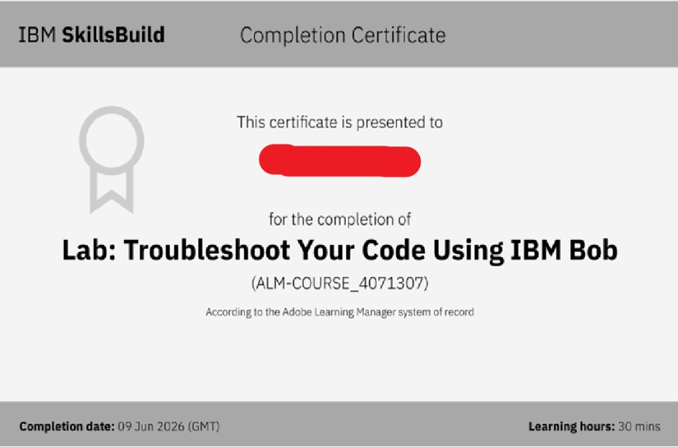
Certificates Earned:​
Add your IBM BOB Certificate

Slide 20


